Slide 1
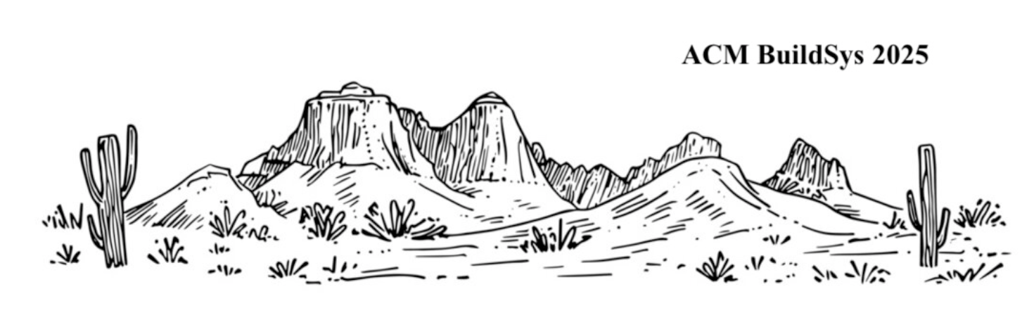
A Novel Aliasing vs Non Aliasing Audio Dataset for Always-On IoT Microphone Experimentation
Jack Adiletta*
Professor Bashima Islam*, Professor Shiwei Fang**
Graduate Students: Khan Hossain*, Matthew Reynolds***
WPI BASH Lab
ACM BuildSys 2025, November 19th
*WPI, **Augusta University, ***Colombia University

Slide 2
Agenda
Problem Space
Aliasing vs Non Aliasing Audio
Generating Aliasing Audio
Errors Generating Aliasing and Non Aliasing Audio
Audio Encoding Techniques
Dataset Structure
Conclusion
Notes:
Neural Network symbol
Fourier series symbol
Op amp symbol
Improve spacing
Verbally say the research includes mathematical analysis, circuit design and analysis, data science and machine learning

Slide 3
Why an Audio Aliasing Dataset is Useful
There is a proliferation of microphones in buildings, cars, urban environments
It is beneficial to have lower sample rate (power / bandwidth, storage)
An aliasing vs non aliasing dataset can be used to optimize the sample rate of a microphone for lowest power/bandwidth/storage without aliasing.
First publicly available dataset to include deliberate aliasing vs non aliasing audio

Slide 4
What is Aliasing Audio?
Nyquist Frequency: Twice the highest frequency of a signal to sample [2]
Aliasing: when audio is sampled at less than the Nyquist Frequency [5]
Aliasing occurs because higher frequencies cannot be represented by a lower sample rate which imparts distortion, audio artifacts, or noise.

Slide 5
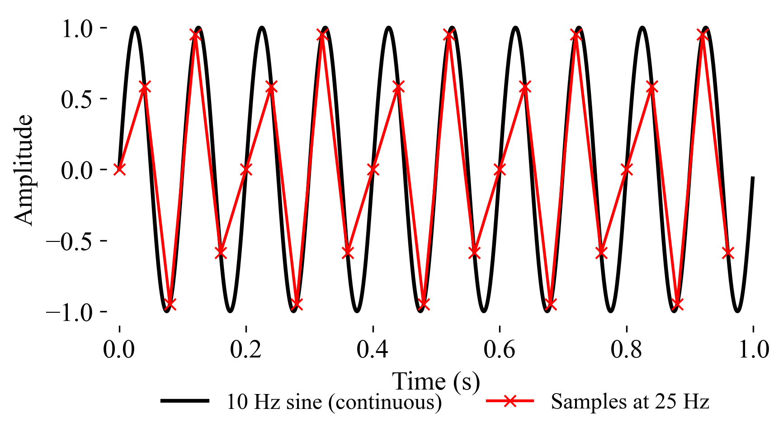
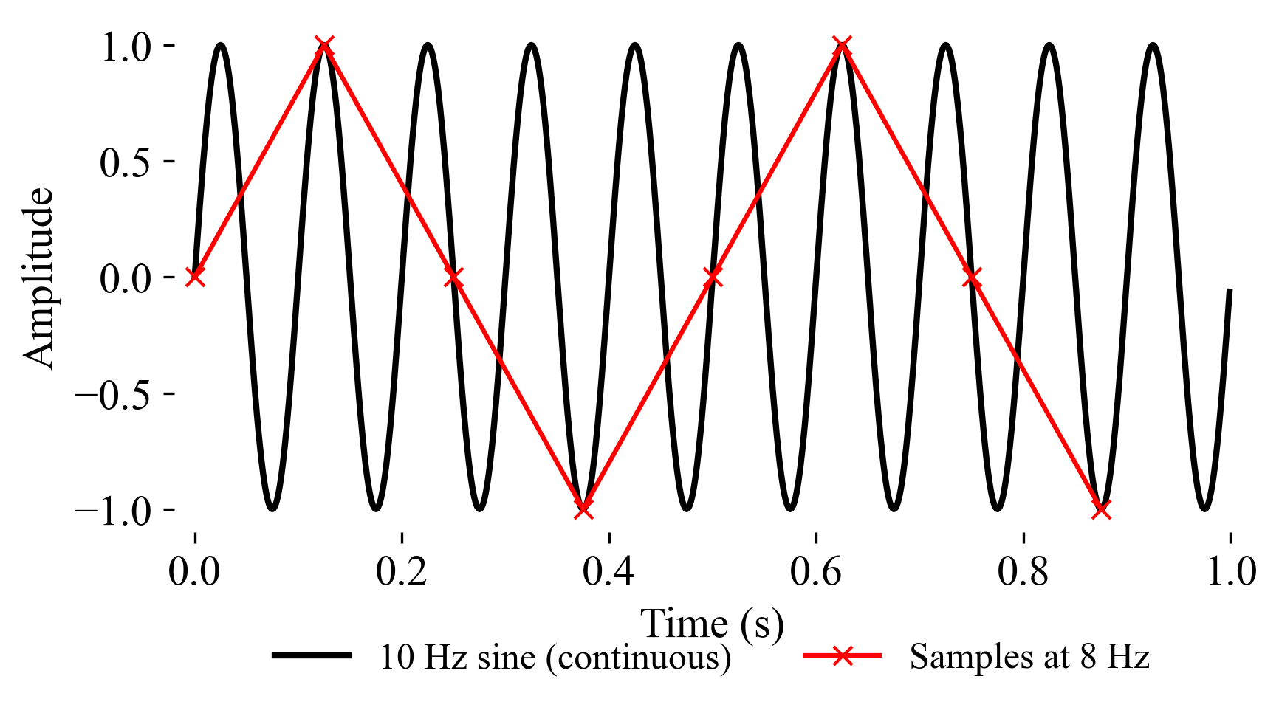

Aliasing Audio Examples
A 10 Hz Sine Wave Sampled at 25 Hz
(Non Aliasing)
A 10 Hz Sine Wave Sampled at 8 Hz
(Aliasing)
Dog Bark Sampled at 22 kHz
(Non Aliasing)
Dog Bark Sampled at 1 kHz
(Aliasing)

Slide 6
Generating a Dataset of Aliasing & Non Aliasing Audio
Example 8 kHz
Process repeated for 1 kHz, 2 kHz, 4 kHz, 16 kHz, 22 kHz
Audio sources are:
Urbansound 8K [3]
ESC 50 [4]
MAVD [5]

Slide 7
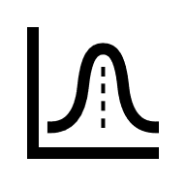



Generating Aliasing & Non Aliasing Audio
Sample at 8 kHz
Playback is aliasing
1s Audio Recording
(contains frequencies above 4 kHz)
Low pass filter at 4 kHz
(remove frequencies above 4 kHz)
Sample at 8 kHz
Playback is non aliasing!

Slide 8


Errors Generating Aliasing & Non Aliasing Audio
Three environmental sound datasets
Urban Sound 8K ~4s
ESC 50 ~5s
MAVD > 1 minutes
Break recording into 1 second chunks
Audio Recording
Sample at 8 kHz
Playback is silent?
Remove recordings with a mean square power less than a threshold

Slide 9
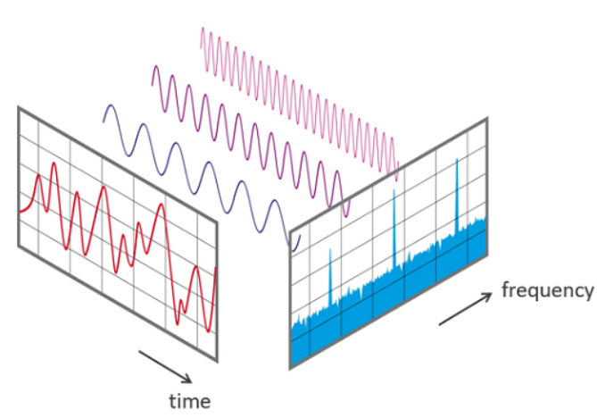
Fast Fourier Transform
[6]

Slide 10
Errors Generating Aliasing Audio
Audio Recording
Sample does not contain frequencies above 4 kHz
Sample at 8 kHz
Playback is loud
but not aliasing?
Remove recordings without high frequencies
Fast Fourier Transform [3]

Slide 11
Encoding Audio Data

Slide 12
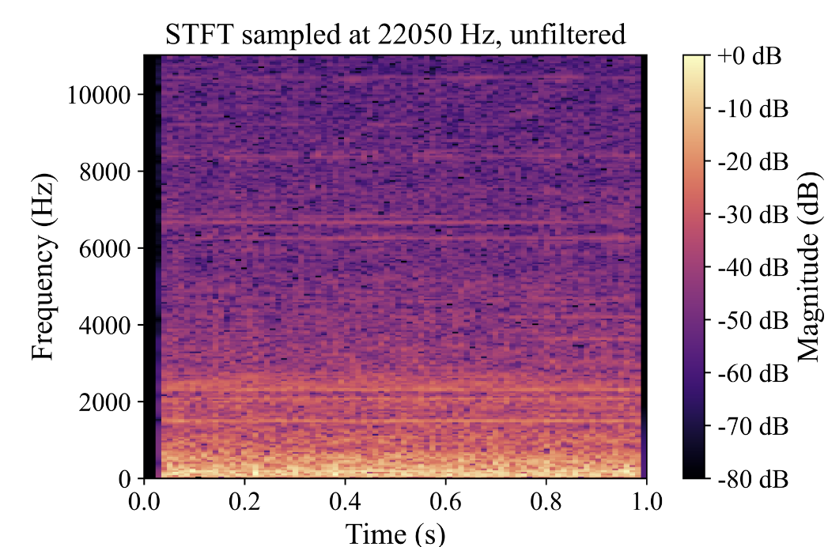
Representing Audio for AI / ML Analysis
Fast Fourier Transform? [6]
Does not capture changes in frequencies over time!
Short Term Fourier Transform (STFT)

Slide 13
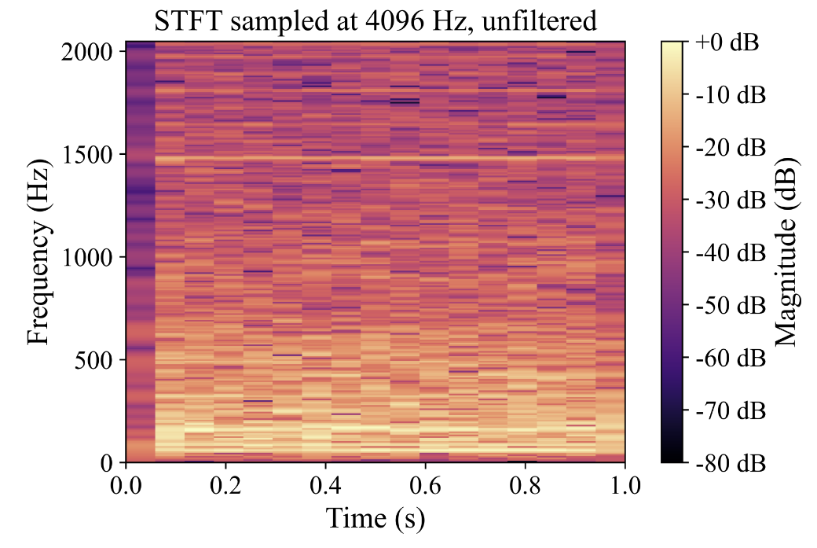
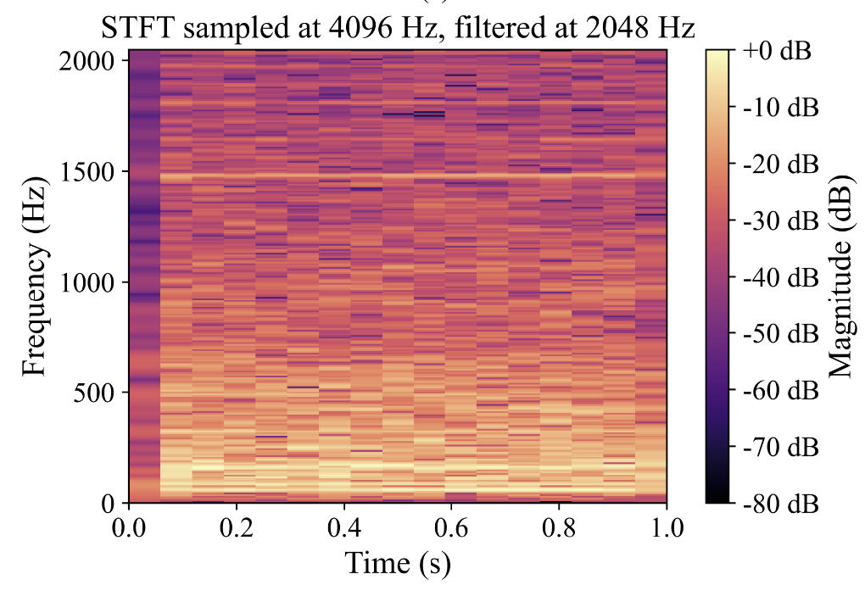
Visual Representation of Aliasing Audio (AC unit)
Unfiltered – Aliasing
Filtered – Non Aliasing
Note: Sampled at 4 kHz

Slide 14
Dataset Structure
Processed_Files/
DS_U8K/ # urbansound 8K
DS_ESC/ # ESC 50
DS_ZEN/ # MAVD Dataset
22000/
16000/
8000/
4000/
2000/
1000/
train/ # 80%
validation/ # 10%
test/ # 10%
filtered/
unfiltered/
Contains 97,891 unique 1-second aliasing and non aliasing samples
Processed into AI/ML friendly STFTs or MFCCs
U8K and ESC50 data samples contain original class (dog bark, AC) in file title

Slide 15
Conclusion and Contributions:
Developed Novel Aliasing / Non Aliasing Audio Generation Method
  Filter audio to generate non aliasing samples
Implemented two audio encoding techniques
  Audio sampled at six sample rates
Published Compressed Dataset
  Available via Zenodo

Slide 16
Thank you!
Questions?

Slide 17
References
[1] Fabian Esqueda, Stefan Bilbao, and Vesa Valimaki. 2016. Aliasing reduction in clipped signals. IEEE Transactions on Signal Processing 64, 20 (2016), 52555267.doi:10.1109/tsp.2016.2585091
[2] Bogdan Mihai. 2009. Sampling rate and aliasing on a virtual laboratory. Journal of Electrical and Electronics Engineering 2 (10 2009).
[3] Justin Salamon, Christopher Jacoby, and Juan Pablo Bello. 2014. UrbanSound8K.
[4] Karol J. Piczak. 2015. ESC: Dataset for Environmental Sound Classification. In Proceedings of the 23rd Annual ACM Conference on Multimedia (Brisbane, Australia,2015-10-13). ACM Press, 1015–1018. doi:10.1145/2733373.2806390
[5] Pablo Zinemanas, Pablo Cancela, and Martín Rocamora. 2019. MAVD: A Dataset for Sound Event Detection in Urban Environments. In Proceedings of the DCASE2019 Workshop. New York, USA, 25–26.
[6] O. Trekhleb, Fourier Decomposition. DEV Community, 2021.

Slide 18
Backups

Slide 19
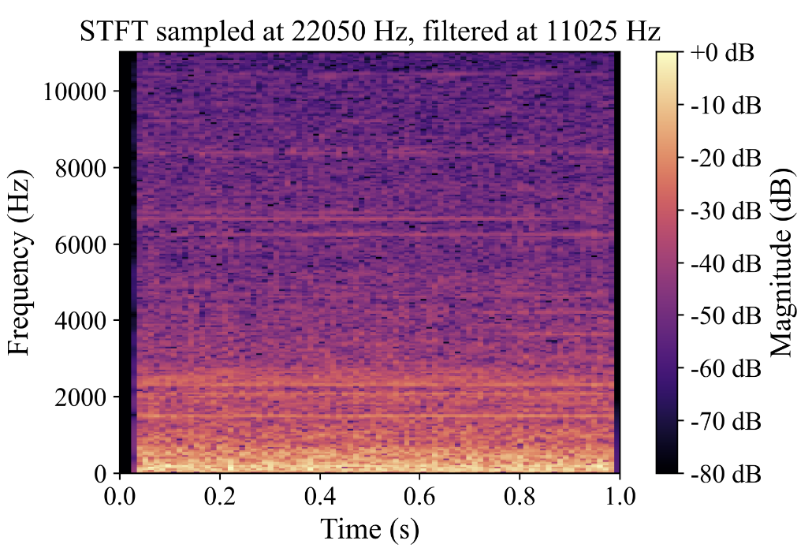
Visual Representation of Aliasing Audio
Unfiltered – Aliasing
Filtered – Non Aliasing
Note: Sampled at 22 kHz

