Slide 1
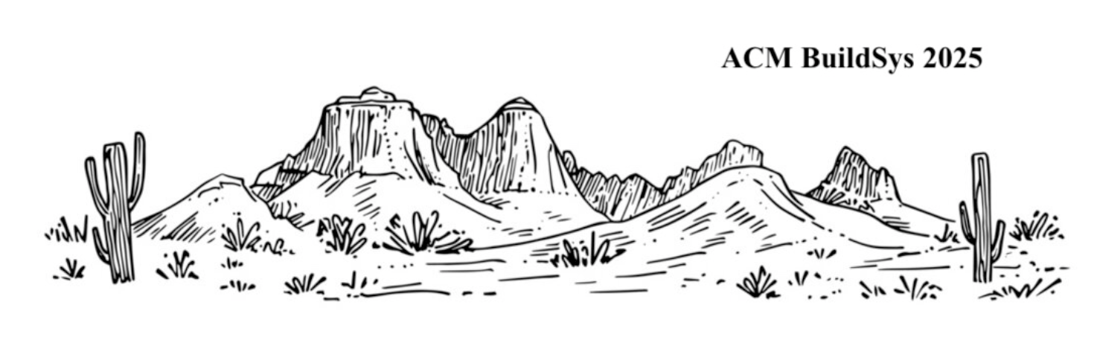
EfficientMic: Adaptive Acoustic Sensing with a Single Microphone for Smart Infrastructure
Jack Adiletta*
Professor Bashima Islam*, Professor Shiwei Fang**
Graduate Students: Khan Hossain*, Matthew Reynolds***
WPI BASH Lab
ACM BuildSys 2025, November 19th
*WPI, **Augusta University, ***Colombia University

Slide 2
Agenda
IoT Microphone Problem Space
Aliasing vs Non Aliasing Audio
Generating Aliasing and Non Aliasing Audio
Sample Rate Optimization
Aliasing Detection Performance
Downstream Task Performance
Conclusion
Notes:
Neural Network symbol
Fourier series symbol
Op amp symbol
Improve spacing
Verbally say the research includes mathematical analysis, circuit design and analysis, data science and machine learning

Slide 3
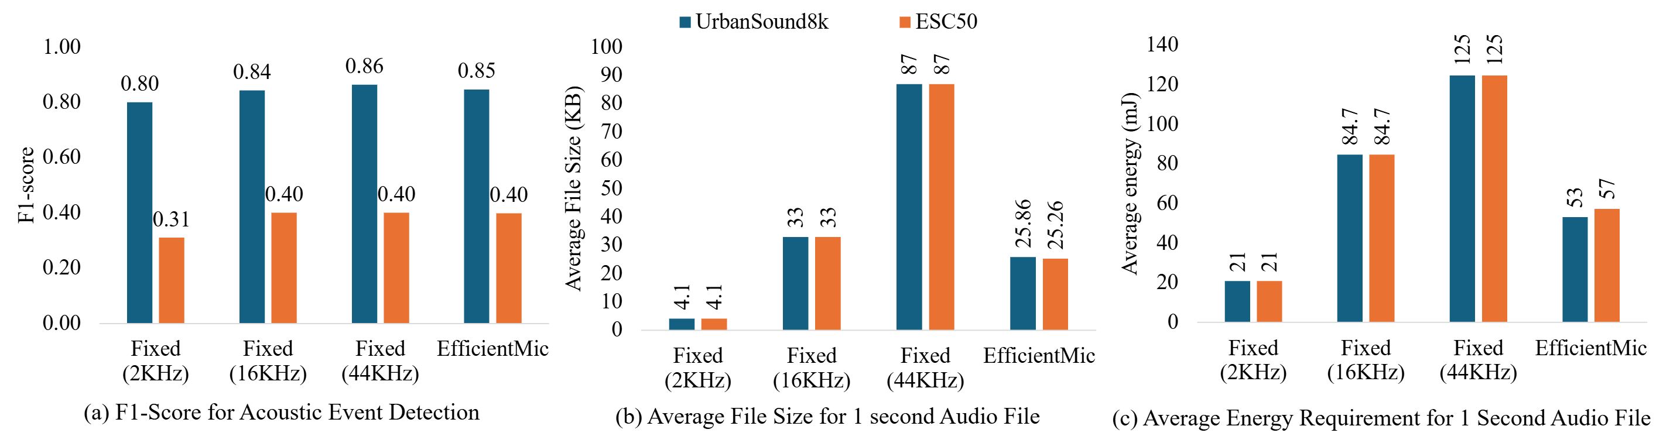
IoT Microphone Problem Space
Very
Beneficial to reduce sample rate when possible!
Size of 1 second, 16-bit Recording
Energy to record 1 second of audio
(On a raspberry PI 3)

Slide 4
What is Aliasing Audio?
Nyquist Frequency: Half the sample rate of a particular recording [2]
Aliasing: when audio contains frequencies above the Nyquist [5]
Aliasing occurs because higher frequencies cannot be represented by a lower sample rate which imparts distortion, audio artifacts, or noise.

Slide 5
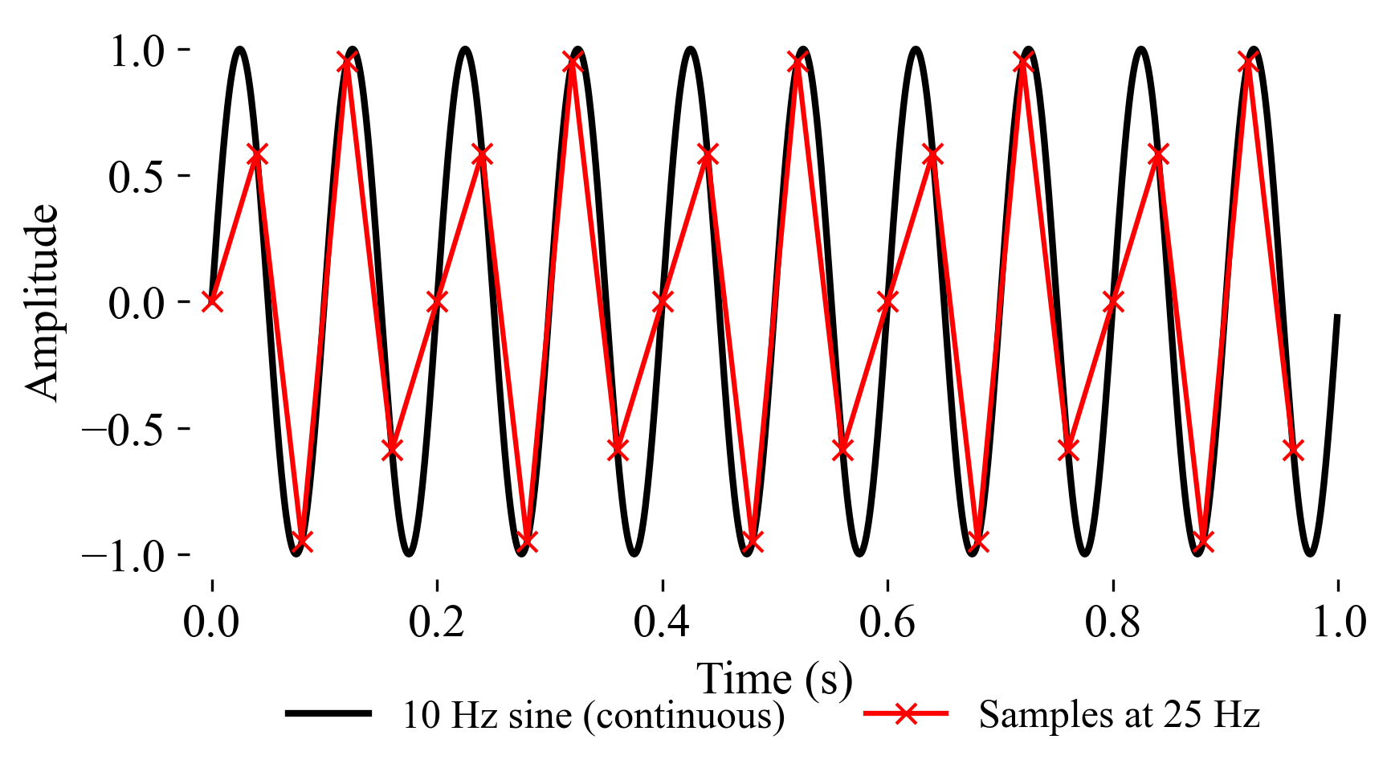
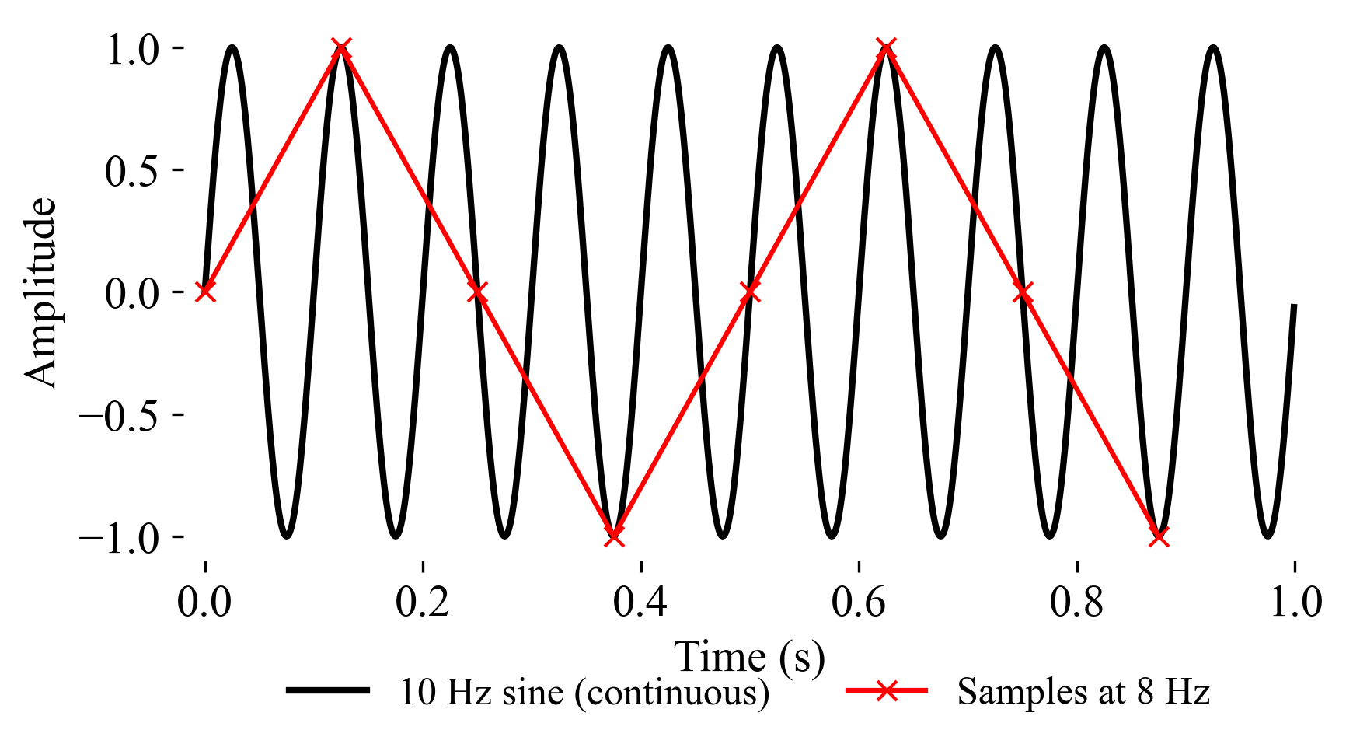

Aliasing Audio Examples
A 10 Hz Sine Wave Sampled at 25 Hz
(Non Aliasing)
A 10 Hz Sine Wave Sampled at 8 Hz
(Aliasing)
Dog Bark Sampled at 22 kHz
(Non Aliasing)
Dog Bark Sampled at 1 kHz
(Aliasing)

Slide 6
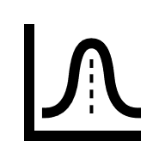



Generating Aliasing & Non Aliasing Audio
Repeat Sampling each 1 second recording at 1 kHz, 2 kHz, 4 kHz, 16 kHz
Can we train an ML
model to differentiate
aliasing vs non aliasing
audio?
Sample at 8 kHz
Playback is aliasing
1s Audio Recording
Recordings generated from 3 datasets:
Urban Sound 8K
ESC 50
MAVD
Low pass filter at 4 kHz
(remove frequencies above 4 kHz)
Sample at 8 kHz
Playback is non aliasing!

Slide 7
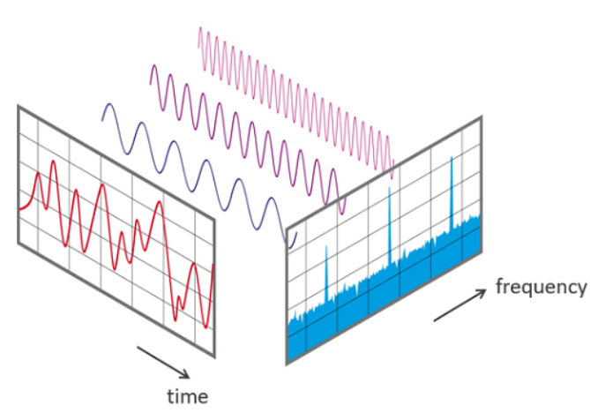
Fast Fourier Transform
[6]

Slide 8
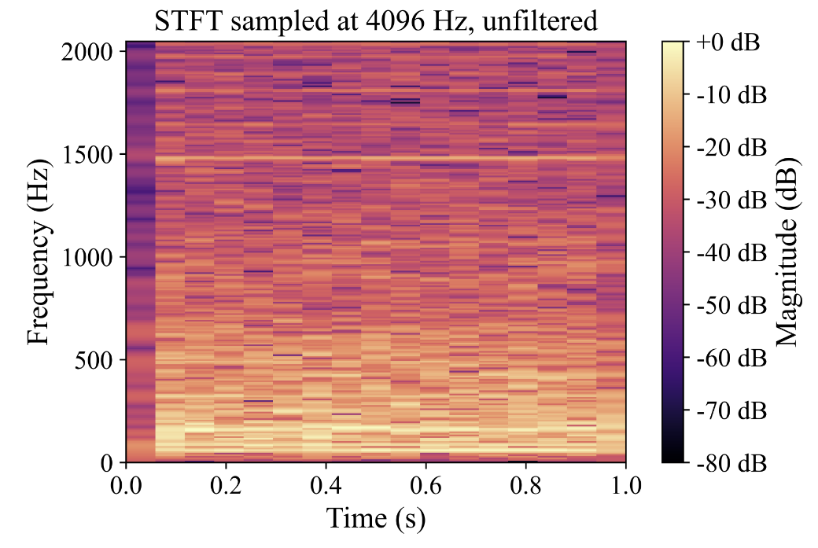
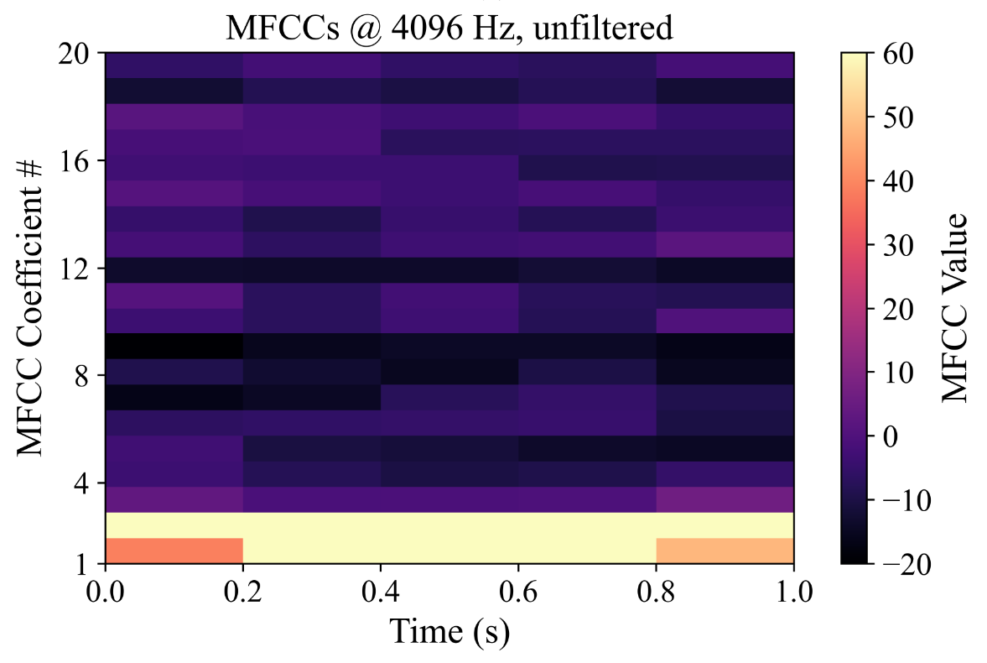
Visual Representation of Aliasing Audio
Short Time Fourier Transform
Mel-frequency Cepstral Coefficients

Slide 9
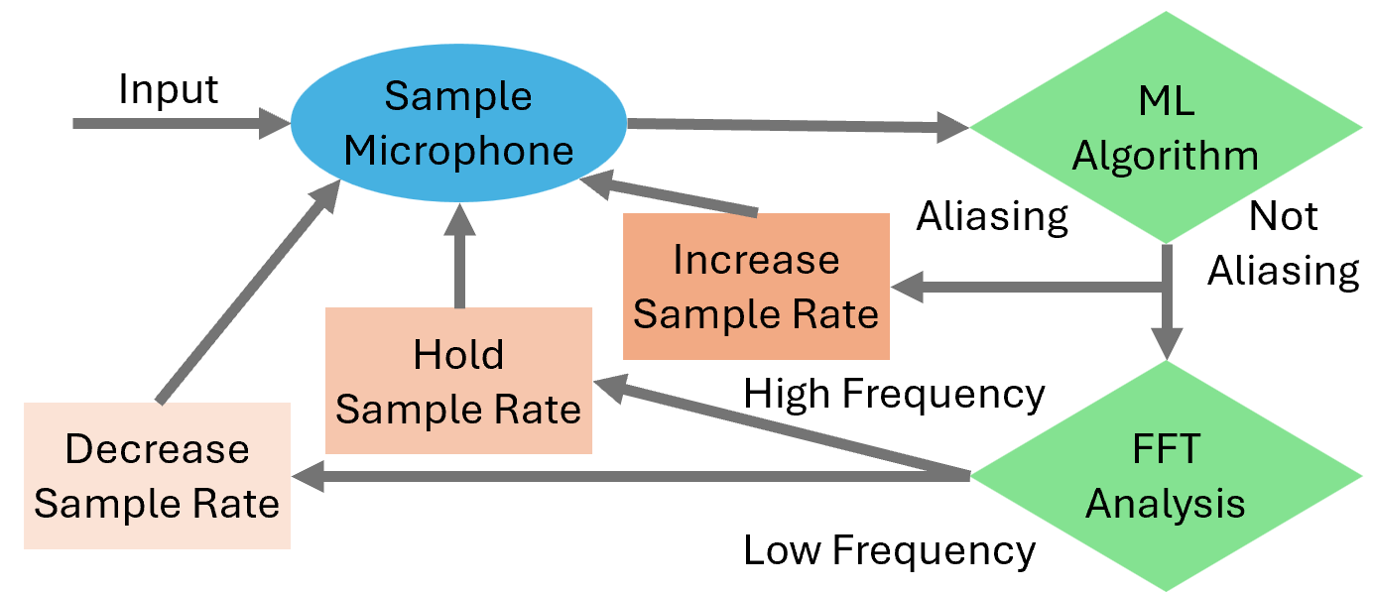
Sample Rate Optimization
or

Slide 10
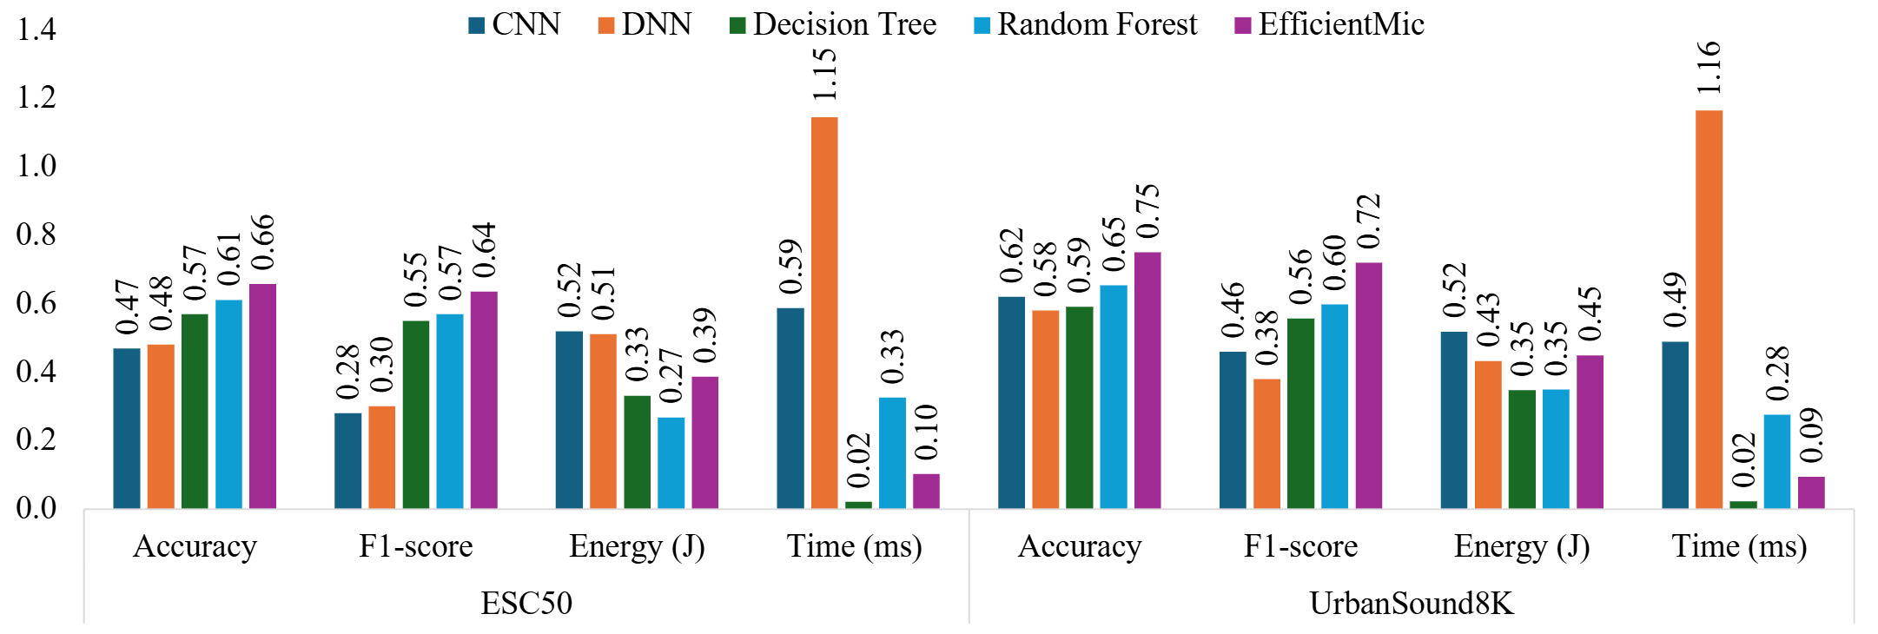
Aliasing Detection Performance

Slide 11
EfficientMic Performance Comparison
Downstream Classification Task
One second audio file size
One second audio recoding energy (Raspberry Pi3)
EfficientMic: If every recording is sampled at the minimum sample rate without aliasing

Slide 12
Conclusion and Contributions:
Developed Novel Aliasing / Non Aliasing Audio Generation Method
  Filter audio to generate non aliasing samples
Developed algorithm to optimize sample rate
  Grid searched lightweight aliasing detection models
Found strong benefits with minimum sample rate
  Minimal performance degradation

Slide 13
Thank you!
Questions?

Slide 14
References
[1] Fabian Esqueda, Stefan Bilbao, and Vesa Valimaki. 2016. Aliasing reduction in clipped signals. IEEE Transactions on Signal Processing 64, 20 (2016), 52555267.doi:10.1109/tsp.2016.2585091
[2] Bogdan Mihai. 2009. Sampling rate and aliasing on a virtual laboratory. Journal of Electrical and Electronics Engineering 2 (10 2009).
[3] Justin Salamon, Christopher Jacoby, and Juan Pablo Bello. 2014. UrbanSound8K.
[4] Karol J. Piczak. 2015. ESC: Dataset for Environmental Sound Classification. In Proceedings of the 23rd Annual ACM Conference on Multimedia (Brisbane, Australia,2015-10-13). ACM Press, 1015–1018. doi:10.1145/2733373.2806390
[5] Pablo Zinemanas, Pablo Cancela, and Martín Rocamora. 2019. MAVD: A Dataset for Sound Event Detection in Urban Environments. In Proceedings of the DCASE2019 Workshop. New York, USA, 25–26.
[6] O. Trekhleb, Fourier Decomposition. DEV Community, 2021.

Slide 15
Backups

Slide 16
Full Analysis Graphic

